Slide 1
Handwriting recognition using machine learning

Slide 2
CONTENTS
BACKGROUND OF THE PROJECT
MOTIVATION TO CHOOSE THE PROJECT
PROJECT GOAL
INNOVATIONS
ALGORITHMS AND TECHNOLOGIES USED
SCOPE OF THE PROJECT

Slide 3
background
Handwritten character recognition is a field of research in artificial intelligence, computer vision, and pattern recognition. A computer performing handwriting recognition is said to be able to acquire and detect characters in paper documents, pictures, touch-screen devices and other sources and convert them into machine-encoded form.

Slide 4
MOTIVATION
Recognizing handwriting and converting them into digitized format makes your task easier and smoother.
Handwriting recognition technology through artificial neural networks (ANNs) is helping us to build platforms that are reflective of the human experience.
The ability to interpret the meaning of users handwritten input in real-time is teaching machines to adapt to the user.

Slide 5
Project goal
The goal is to provide the best user experience depending on the situation or venue.
There will be times when you need a full sized keyboard for those long documents. Equally, there will be occasions where it will be optimal to write with a pen on your tablet.

Slide 6
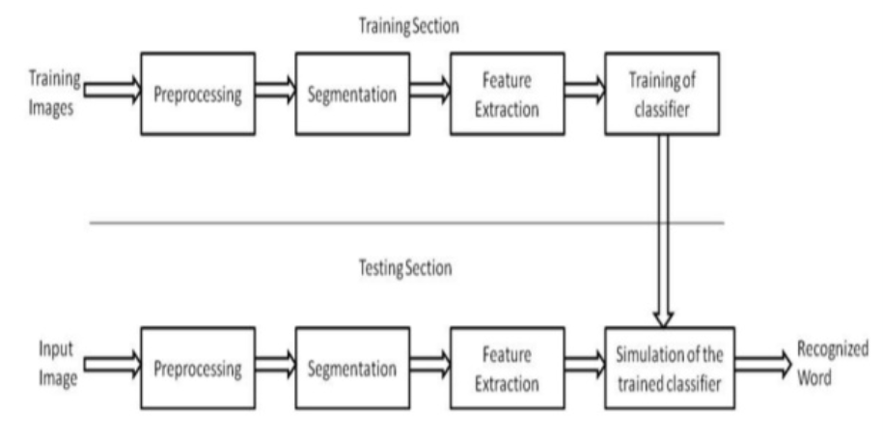
implementation

Slide 7
Applications
Postal Address reading
Check reading
Census data collection and processing
Image document reading
Digitizing old books in edible form

Slide 8
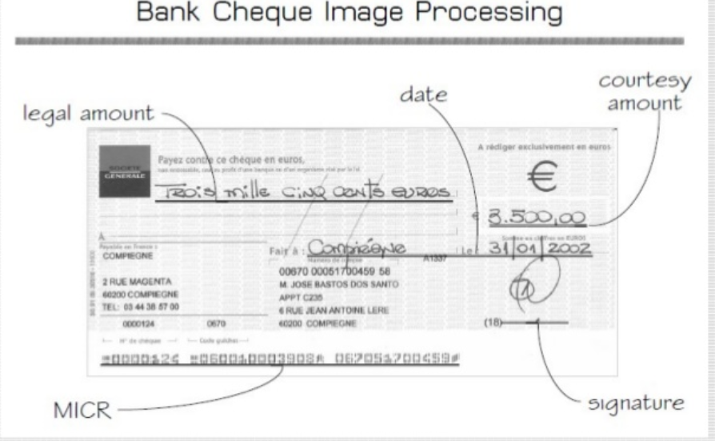

Slide 9
TECHNOLOGIES USED
The use of convolutional neural networks (CNNs) peaked in 2011, achieving a tiny 0.27% error rate.
To do this, seven deep CNNs trained identical classiﬁers on data, pre-processed in diﬀerent ways.
Optical character recognition (OCR) is used to convert handwritten text into machine encoded texts.

Slide 10
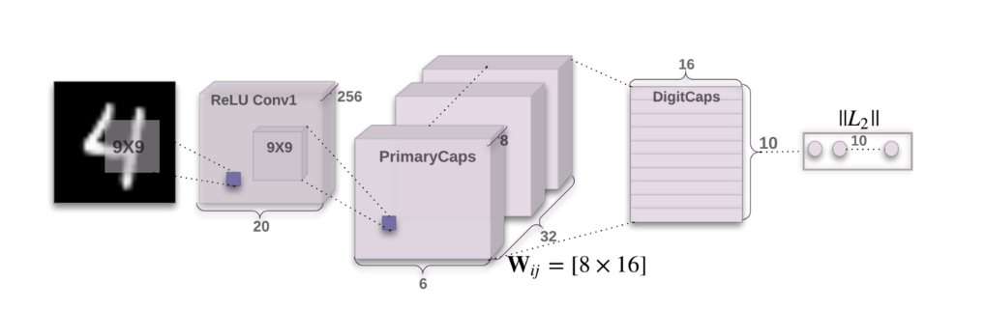
Capsule Networks(CapsNets) improve on the results of CNNs in a number of ways, particularly the following:
Reduces the effects of spatial variance, found using CNN methods.
Reduces the amount of data required for training.

Slide 11
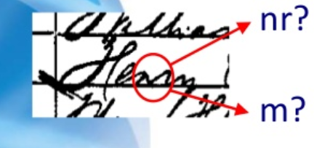
constraints
Types of handwriting
Number of scripters
Size of the vocabulary
Spatial layout

Slide 12
scope
Handwriting recognition could replace the keyboard.
Text to speech conversion.
Visually impaired could be able to access computers in their native languages.

Slide 13
references
https://www.slideshare.net/dongrevj/character-recognition
https://towardsdatascience.com/build-a-handwritten-text-recognition-system-using-tensorflow-2326a3487cd5
https://medium.com/the-andela-way/applying-machine-learning-to-recognize-handwritten-characters-babcd4b8d705

